Slide 1
Knapsack Problem and its Application
knapsack problem:
n items.
Item i is worth $v_{i} , weighs w_{i} pounds.
Find a most valuable subset of items with total weight ≤ W.
0 or 1, fractional
No duplicate items (1, k, ∞）
Other applications

Slide 2
0-1 Knapsack vs. Fractional Knapsack Problem

Slide 3
THE MAIN CONTENTS
01
Question Introduction
02
Problem Analysis
03
Algorithm Explanation
04
Solution Optimization
05
More Extensions
06
Summary & Highlight

Slide 4
1
Problem Solving

Slide 5
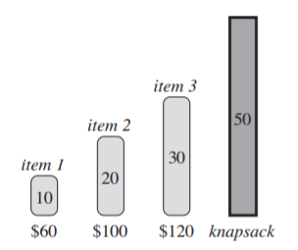

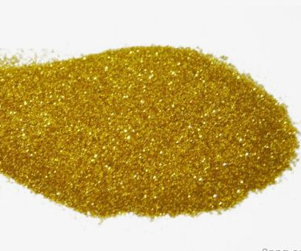
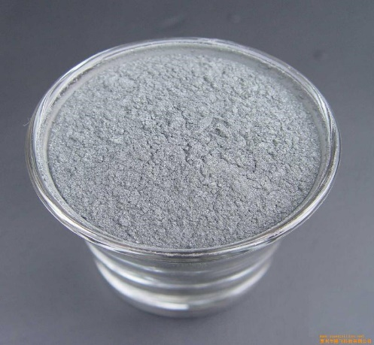
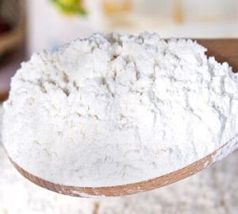

01
Question Introduction
Fractional Knapsack Problem
A thief robbing a store finds n items. The $ⅈ$th item is worth $ν_{i}$ dollars and weighs $w_{i}$ pounds, where $ν_{i}$ and $w_{i}$ are integers. The thief wants to take as valuable a load as possible, but he can carry at most C pounds in his knapsack, for some integer C. Which items should he take?
He can take fractions of items.
LOGO

Slide 6
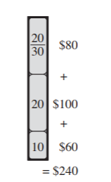
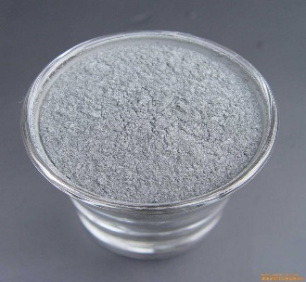
02
Problem Analysis
Greedy !
6$/pound | 5$/pound | 4$/pound
LOGO

Slide 7
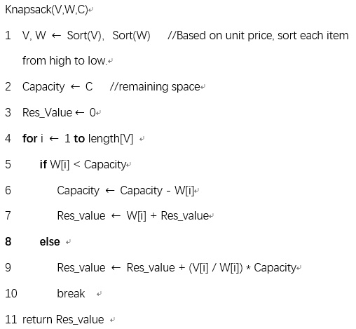
03
Algorithm Explanation
Time: O(nlgn)
Space: O(n)
LOGO

Slide 8
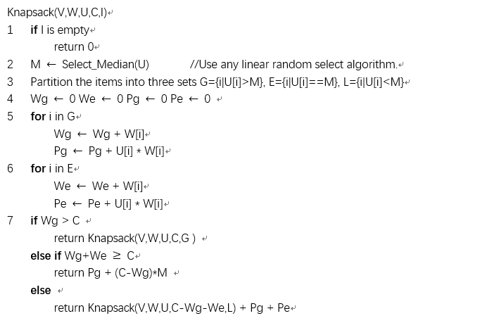
03
Algorithm Explanation
16.2-6 ⋆ Show how to solve the fractional knapsack problem in O(n) time.
Select algorithm
Time: O(n)
Space: O(n)
LOGO

Slide 9

04
Correctness Proof
1. First, assume that the item set S={W1, W2....Wn} has been sorted from small to large in terms of unit weight value.
2. Second, assume that a global optimal solution is: S(i) = {Wi1, Wi2, .....Win}. Wi1, Wi2, .....Win is orderly. For greedy choices, Wn items are always preferred. When Wn is not available, select Wn-1 .....
If Win = Wn, the problem has been proven. Because our optimal solution S(i) already contains greedy choices.
As long as we continue to summarize, Wi(n-1) is Wn-1 ....
If Win != Wn ,we use the pruning technique, cut out Win and paste Wn’(Win <= Wn’ <=capacity) at this point to get a better solution (because the value is greater, Wn’ >= Win).
This proves that if you choose with a greedy strategy, you get the optimal solution. In this way, we prove the correctness of the greedy algorithm.
LOGO

Slide 10

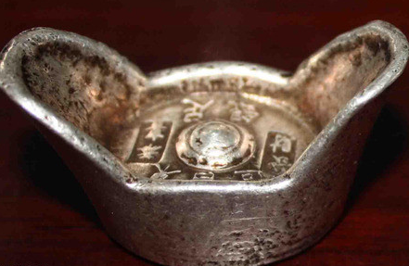
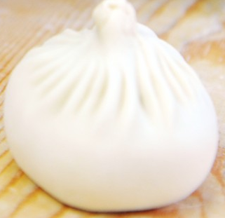
01
Question Introduction
0/1 Knapsack Problem
The thief continues robbing another store. However, for each item, the thief must either take it or leave it behind. He cannot take a fractional amount of an item. Which items should he take?
He can only choose to take or not take.
LOGO

Slide 11
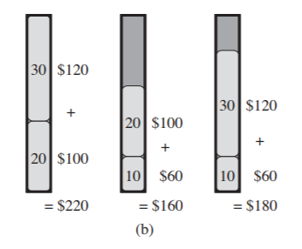
02
Problem Analysis
6$/pound | 5$/pound | 4$/pound
Better!
Greedy?
Bad!
LOGO

Slide 12

02
Problem Analysis
6$/pound | 5$/pound | 4$/pound
6$/kg | 5$/kg | 4$/kg
Dynamic Programming !
Better!
Greedy?
Bad!
LOGO

Slide 13
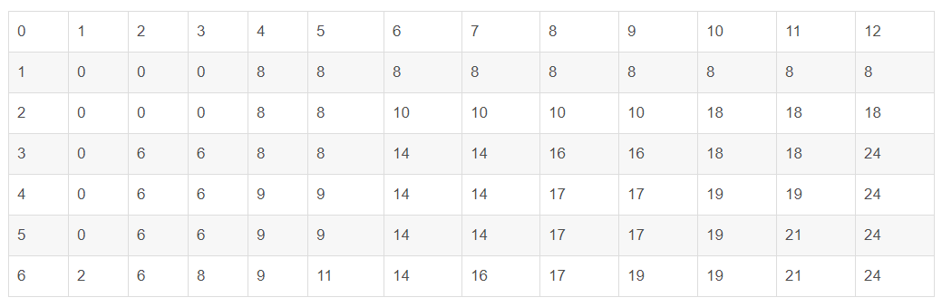
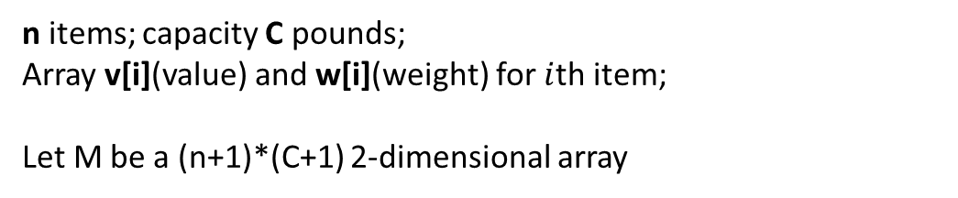
02
Problem Analysis
n items; capacity C pounds;
Array v[i](value) and w[i](weight) for $i$th item;
Let M be a (n+1)*(C+1) 2-dimensional array
Dynamic Programming !
v = {8, 10, 6, 3, 7, 2}
w = {4, 6, 2, 2, 5, 1}
C = 12
LOGO

Slide 14
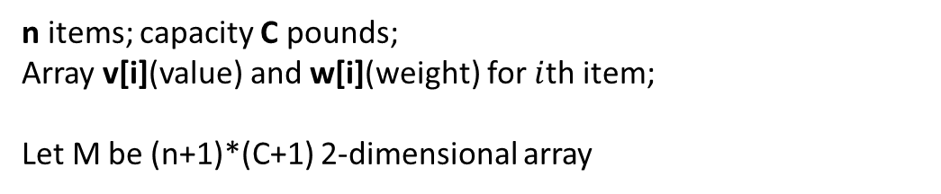
02
Problem Analysis
n items; capacity C pounds;
Array v[i](value) and w[i](weight) for $i$th item;
Let M be (n+1)*(C+1) 2-dimensional array
(1) j < w[i], the knapsack can not hold this item for it is too heavy. We can only choose to throw it away.
m[ i ][ j ] = m[ i-1 ][ j ]
v = {8, 10, 6, 3, 7, 2}
w = {4, 6, 2, 2, 5, 1}
C = 12
LOGO

Slide 15
02
Problem Analysis
n items; capacity C pounds;
Array v[i](value) and w[i](weight) for $i$th item;
Let M be a (n+1)*(C+1) 2-dimensional array
(2) j >= w[i], We can hold this item for just throw it. We need to compare which choice is better.
if take,
m[ i ][ j ]=m[ i-1 ][ j-w[ i ] ] + v[ i ] = 14
if not take, same as (1)
m[ i ][ j ] = m[ i-1 ][ j ] = 10
we take the larger one.
v = {8, 10, 6, 3, 7, 2}
w = {4, 6, 2, 2, 5, 1}
C = 12
LOGO

Slide 16
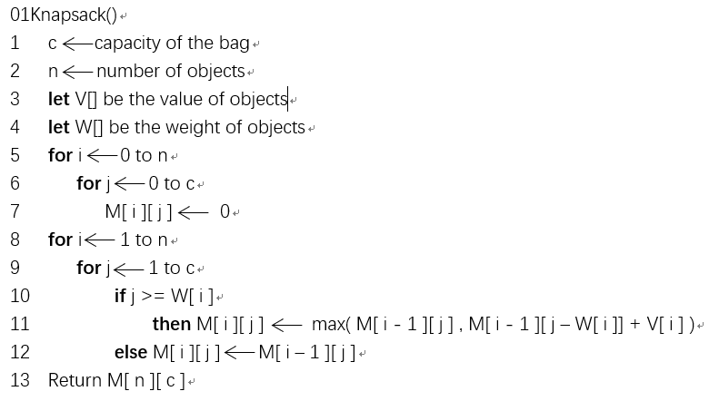
03
Algorithm Explanation
Time: O(n * c) Space: O(n * c)
LOGO

Slide 17
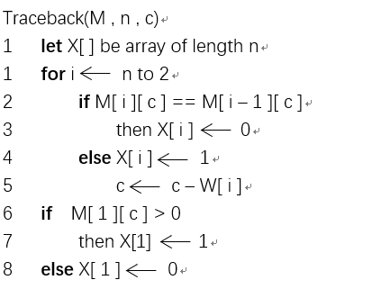
03
Algorithm Explanation
LOGO

Slide 18
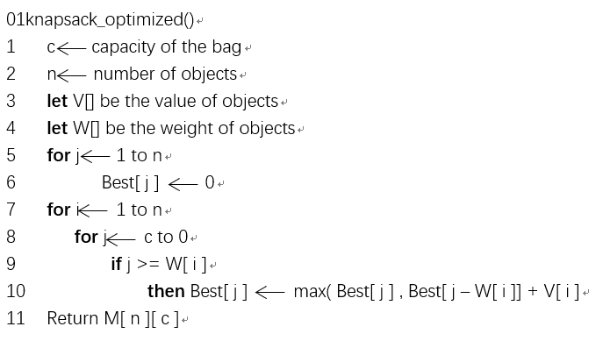
03
Algorithm Optimization
Time: O(n * c) Space: O(c)
But we can not trace this time.
LOGO

Slide 19
03
Algorithm Optimization
LOGO

Slide 20
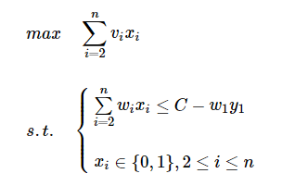
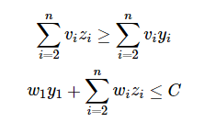

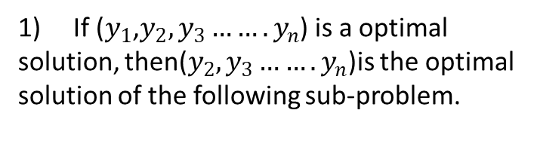
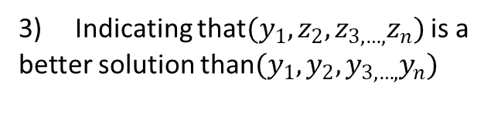
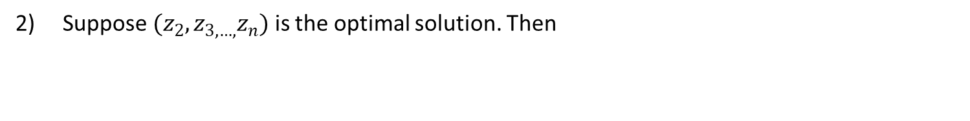
04
Correctness Proof
1) If ($y_{1}$,$y_{2},y_{3}…….y_{n}$) is a optimal solution, then($y_{2},y_{3}…….y_{n}$)is the optimal solution of the following sub-problem.
3) Indicating that$(y_{1},z_{2},z_{3,…,}z_{n})$ is a better solution than$(y_{1},y_{2},y_{3,…,}y_{n})$
2) Suppose $(z_{2},z_{3,…,}z_{n})$ is the optimal solution. Then
LOGO

Slide 21
2
Extensions
By Chunhao Hu

Slide 22
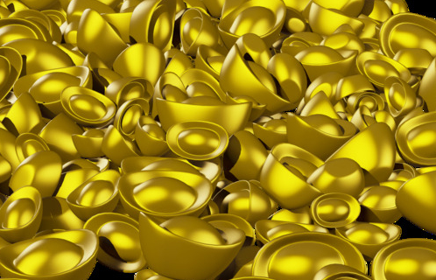
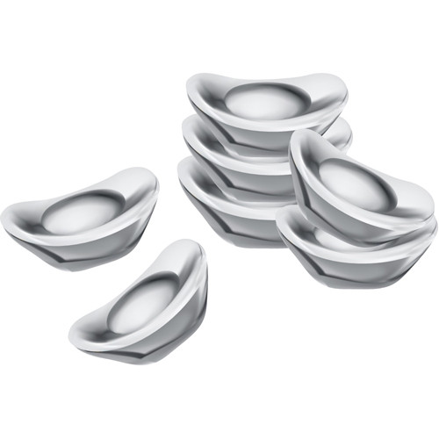
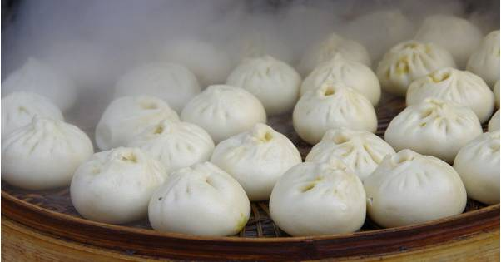

01
Question Introduction
Knapsack Problem/Unbounded
(variant of 0/1 knapsack problem)
The thief continues robbing the 3rd store. However, for each item, he can put as many times as he wants. Which items should he take?
If capacity allows, you can put 0,1,2,…,$∞$ items for each type.
LOGO

Slide 23
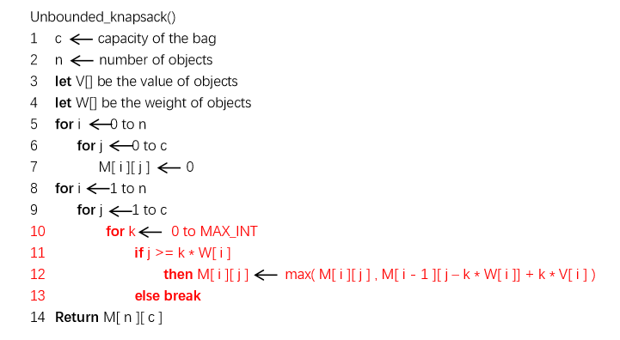
03
Extended Algorithm
Time: O(n * c) Space: O(n * c)
LOGO

Slide 24
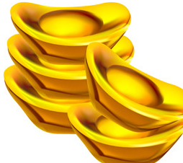
01
Question Introduction
Knapsack Problem/Bounded
(variant of 0/1 knapsack problem)
The thief continues robbing the 4th store. However, for each item, the amount is a constant. Which items should he take?
For each type, the amount of it is given. (e.g. 3)
5
2
3
LOGO

Slide 25
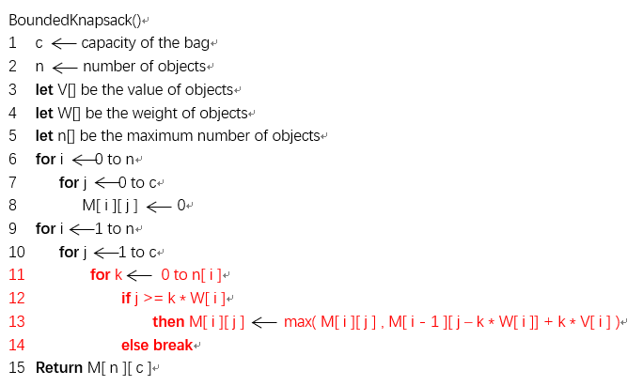
03
Extended Algorithm
Time: O(n * c) Space: O(n * c)
LOGO

Slide 26
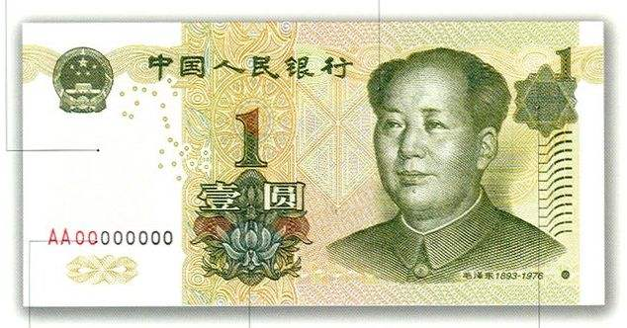
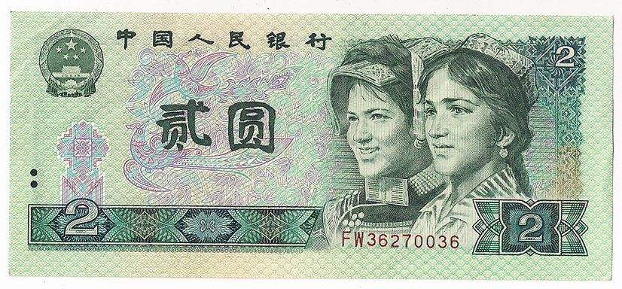
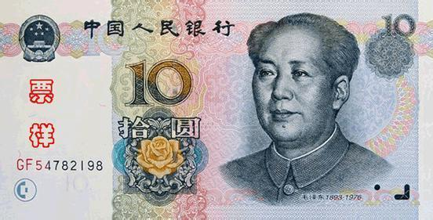
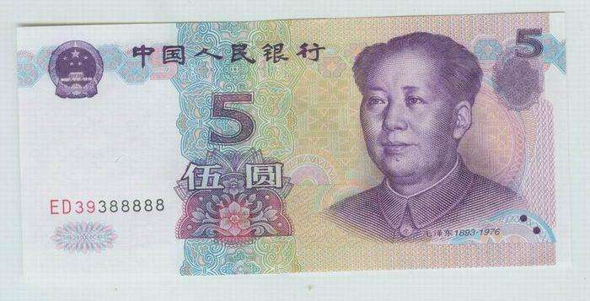
01
Question Introduction
monetary system
(transformation of knapsack problem)
Unbounded!
Example:
If you have a monetary system which consists of n infinite different values, give the number of combinations to achieve the value of m.
e.g:
n = 3 m = 10
Values: 1 2 5
Give: number of combinations ?
5
2
3
LOGO

Slide 27
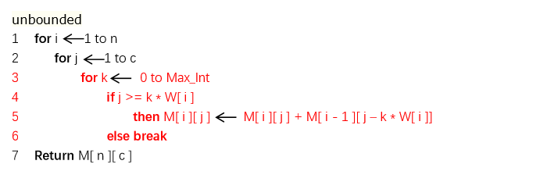
03
Extended Algorithm
M[ i ][ j ] = M[ i ][ j ] + M[ i - 1 ][ j – k * W[ i ]]
Time: O(n * c) Space: O(n * c)
LOGO

Slide 28
3
Summary & Highlight
By Zehua Guo

Slide 29

02
Commonality & characteristics
Optimal Sub-Structure
Greedy Standard
Both dynamic programming algorithms and greedy algorithms contain optimal sub-structure. The optimal solution to the problem contains the optimal solutions to its sub-problems
According to greedy-choice strategy, the optimal selection at the current stage is accumulated.
01
01
Overlapping Sub-problems
Local & Global
The recursive algorithm of the problem will solve the same sub-problem repeatedly, instead of always generating new sub-problems.
The accumulation of local optimal solutions does not guarantee global optimization. For example, greedy algorithm can’t solve 0-1 knapsack problem.
02
02
Linear Derivation &Tree Search
Greedy algorithm eliminates many sub-problems each time, and directly obtains the next result from the current optimal solution. Dynamic programming algorithm, which optimizes by retaining the results of sub-problems, is a tree-structured search problem.
03
LOGO

Slide 30
06
Summary & Highlights
Optimal Sub-structure?
01
The optimal solution of a problem contains the optimal solution of sub-problems. This is the key factor of dynamic programming algorithm and greedy algorithm.
Greedy Standard?
02
Greedy algorithm does not have a fixed algorithm solution framework, the key of the algorithm is the choice of greedy strategies.
Dynamic Programming!
03
If the global optimal solution can not be obtained by accumulating the local optimal solutions, we use dynamic programming algorithm.
Greedy algorithm can get the optimal solution by accumulating the local optimal solutions, which does not guarantee that the global solution can always be generated. But in many cases, greedy algorithms are very effective.
The greedy-choice strategy is crucial. We must ensure the optimal solution at each step is secure.
LOGO

Slide 31
Some Dynamic Problems
Knapsack Problem
Maximum Sub-array Problem
Coin Change Problem
Minimum Edge Distance Problem
Longest Monotonically Subsequence Problem

